Slide 1







SHELF OF TALES
A Book Recommendation System
NAME | ROLL NO.
HIYA KASHYAP | 2210990415
HUNARDEEP KAUR | 2210990417
ILLU SAINI | 2210990418
ISHPREET KAUR | 2210990424

Slide 2




Content
● Problem statement
● Data Summary
● Analysis of different datasets
● Recommendation Model
● Challenges
● Conclusion
● Future Scope
25%

Slide 3





Problem Statement
During the last few decades, with the rise of Youtube, Amazon, Netflix, and many other such web services, recommender systems have become much more important in our lives in terms of providing highly personalized and relevant content.
The main objective is to create a recommendation system to recommend relevant books to users based on popularity and user interests.

Slide 4
Data Summary
The dataset is comprised of three csv files:: Users, Books, Ratings
Users_Dataset:
User ID( (unique for each user)
Location
Age Shape of dataset: (278858, 3)
Books_Dataset:
ISBN (unique for each book)
Book-Title
Book-Author
Year-Of-Publication
Publisher
Image-URL-SY
Image-URL-M
Image-URL-L
Shape of Dataset - (271360, 8)

Slide 5
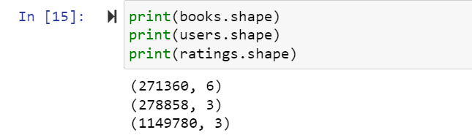
Ratings_dataset:
User ID
ISBN
Book-Rating Shape of dataset: (1149780, 3)
25%

Slide 6
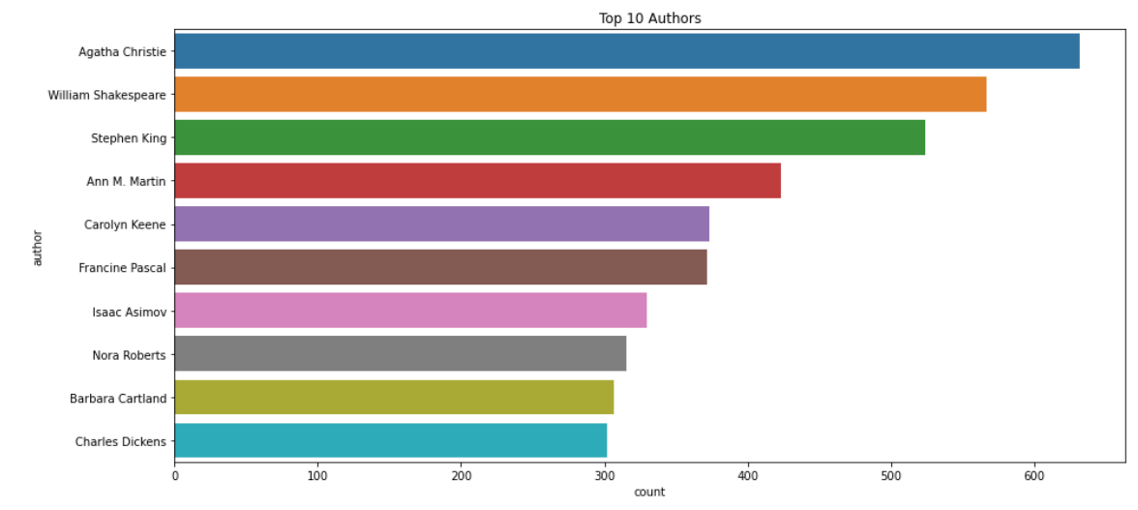
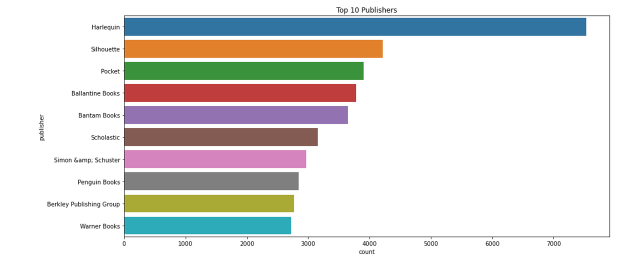
Data Visualisation
Top 10 Authors who have written the most books.
Top 10 Publishers who have published the most books

Slide 7
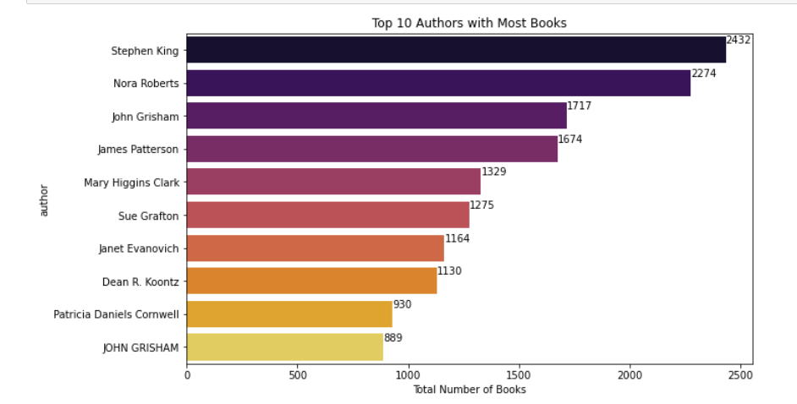
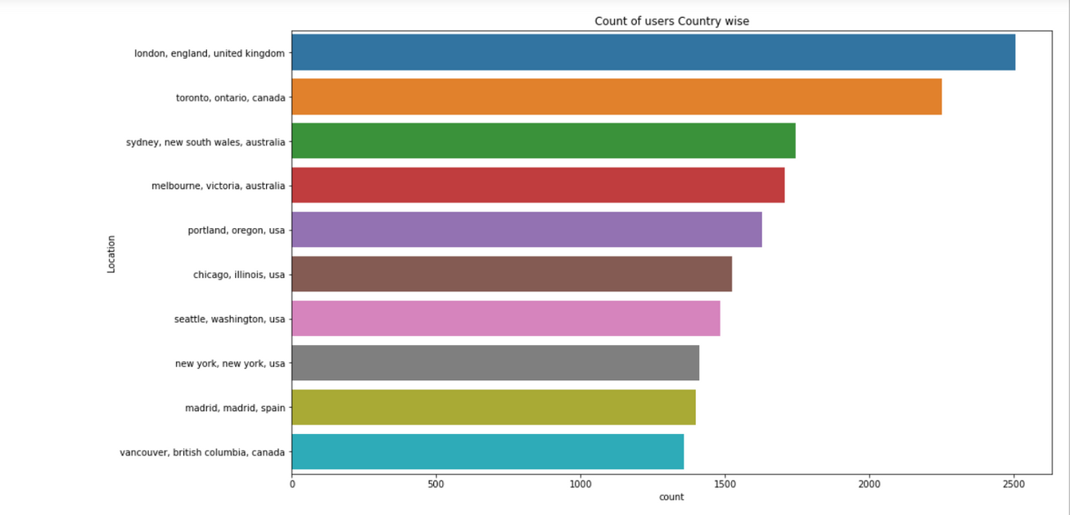
Top 10 Authors with most number of books
25%
75%
Count of users country wise

Slide 8
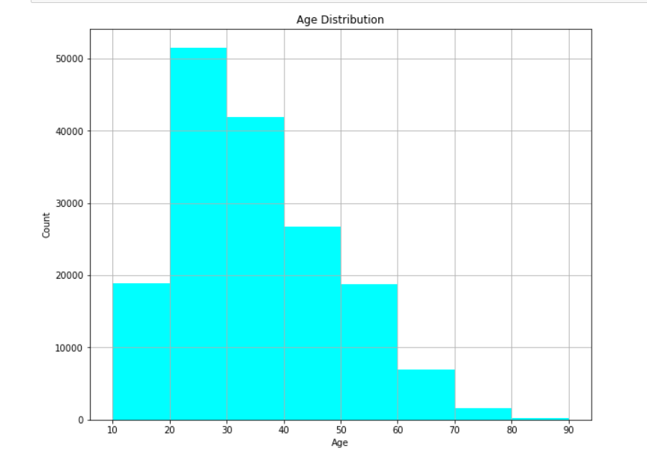
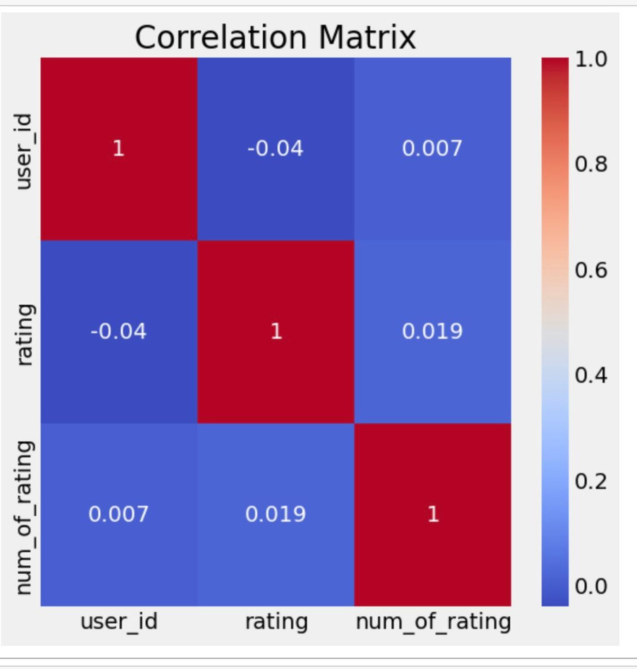
Age Distribution of users

Slide 9
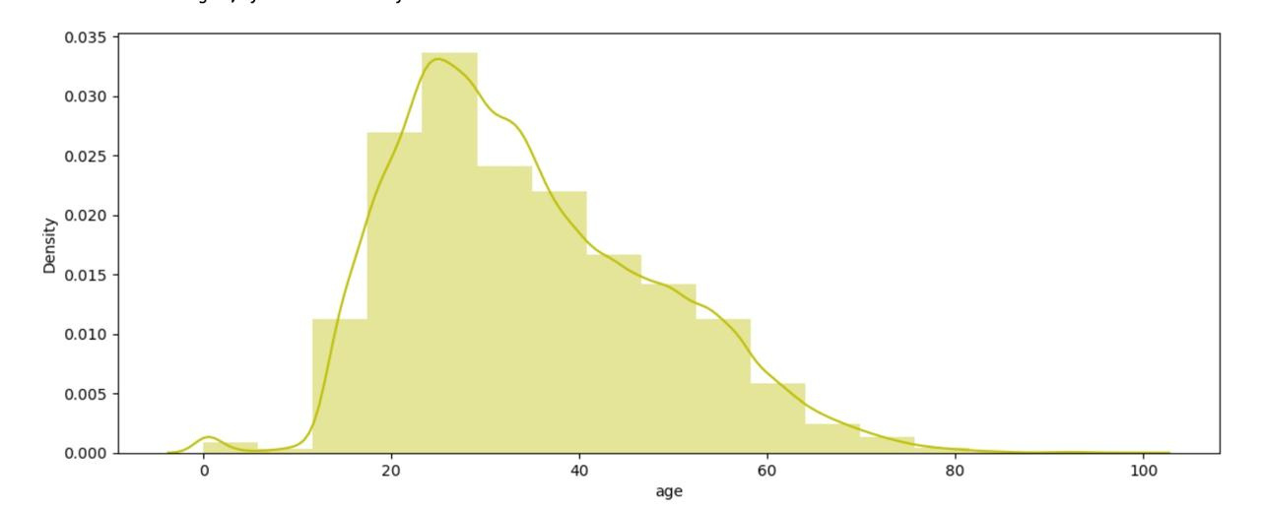
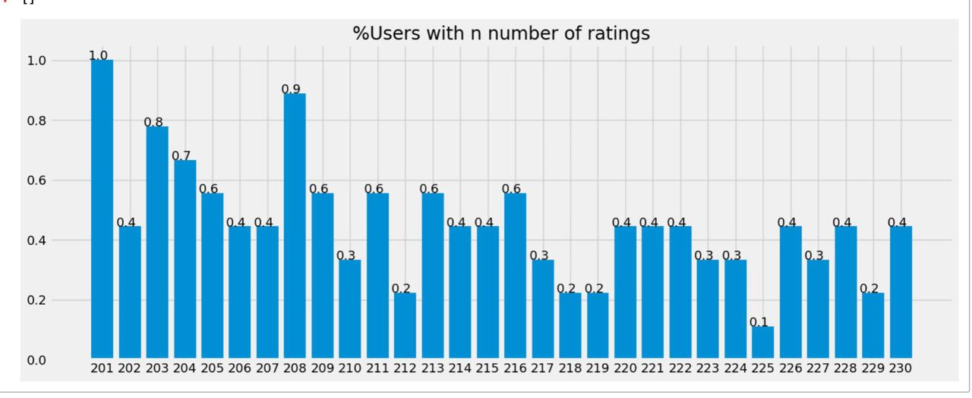

Slide 10


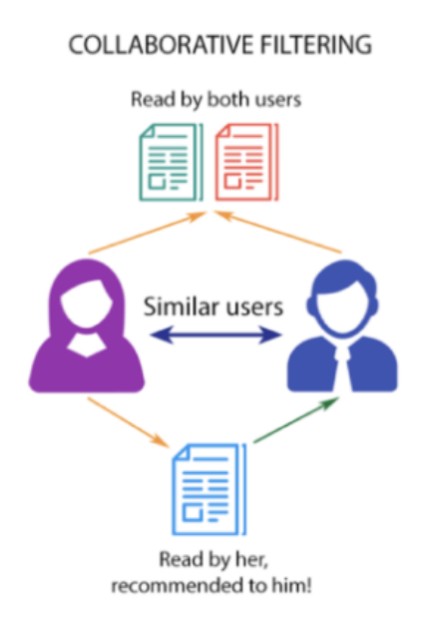
Collaborative Filtering
Collaborative filtering is a technique used by websites like Amazon, YouTube, and Netflix. It filters out items that a user might like on the basis of reactions of similar users. There are two categories of collaborative filtering algorithms: memory based and model based.

Slide 11
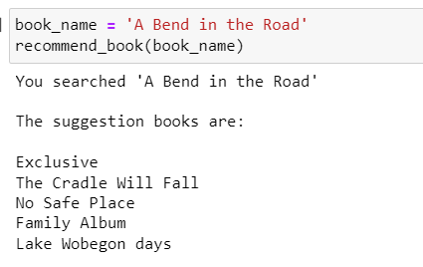
Result Using Collaborative Filtering
25%
75%

Slide 12

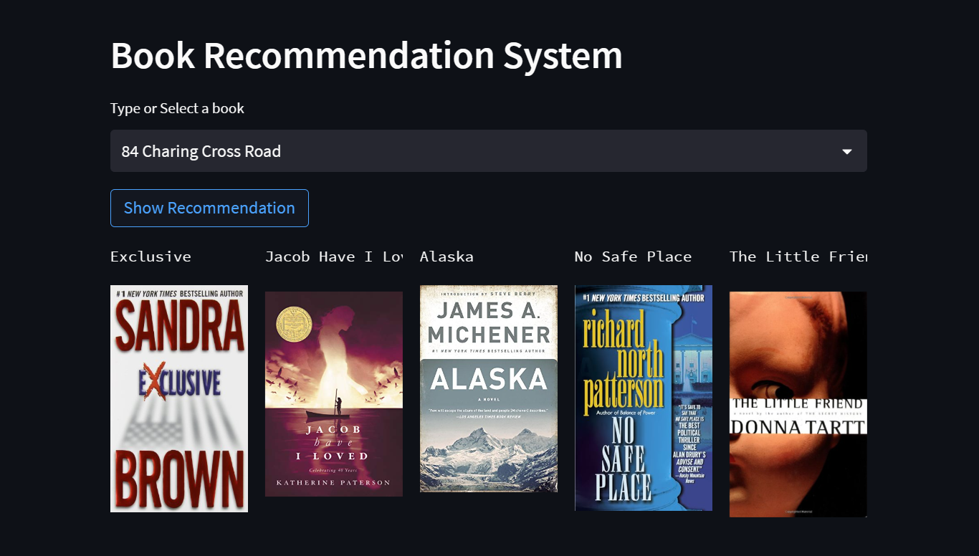


Deployment
Used Streamlit to deploy application

Slide 13
Conclusion
Majority of the readers were of the age bracket 20-35 and most of them came from North American and European countries namely USA, Canada, UK, Germany and Spain.
If we look at the ratings distribution, most of the books have high ratings with maximum books being rated 8. Ratings below 5 are few in number.
Author with the most books was Agatha Christie, William Shakespeare and Stephen King.
For modelling, it was observed that for model based collaborative filtering nearest neighbours technique worked very well on the dataset.
25%
75%

Slide 14
Future Scope
Given more information regarding the book dataset, namely features like Genre, Description etc, we could implement a content-filtering-based recommendation system and compare the results with the existing collaborative-filtering-based system.
We would like to explore various clustering approaches for clustering the users based on Age, Location etc., and then implement voting algorithms to recommend items to the user depending on the cluster into which it belongs.

Slide 15


THANK YOU

